Slide 1
CircleSpace
School club platform for all university students
날다람쥐랩 김구호 배석현 박진우 정지우

Slide 2
01
02
03
04
05
06
Background
Problem
Solution & Expectation
Technique
Architecture
Development plan
Contents

Slide 3





01 Background
These days, many universities host a wide variety of clubs, which have become an essential part of campus life for students.
However... how do we search for these club informations?

Slide 4
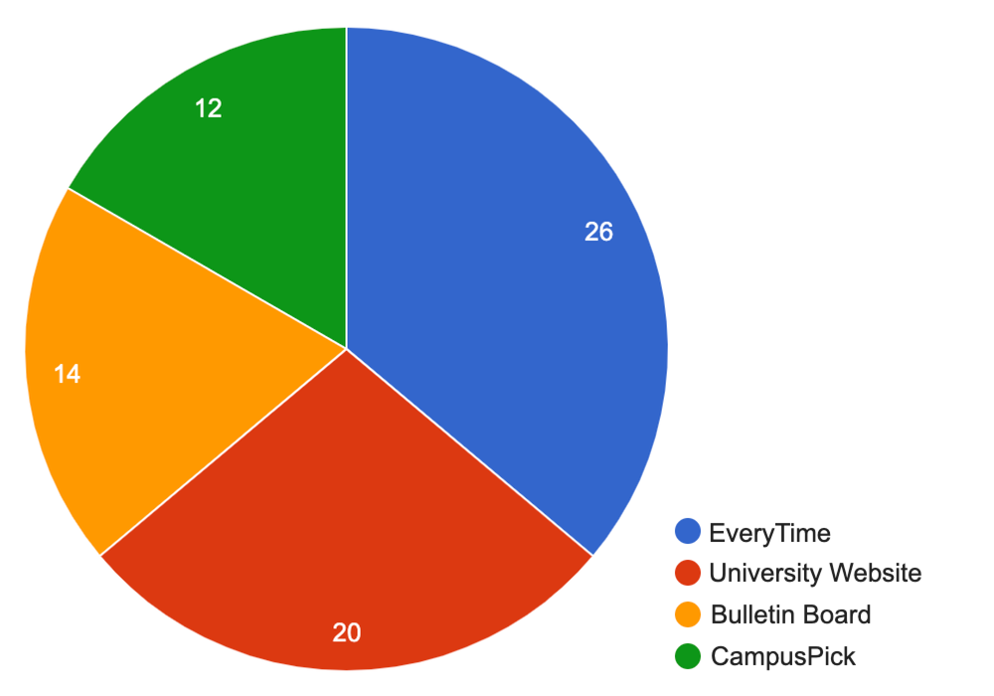
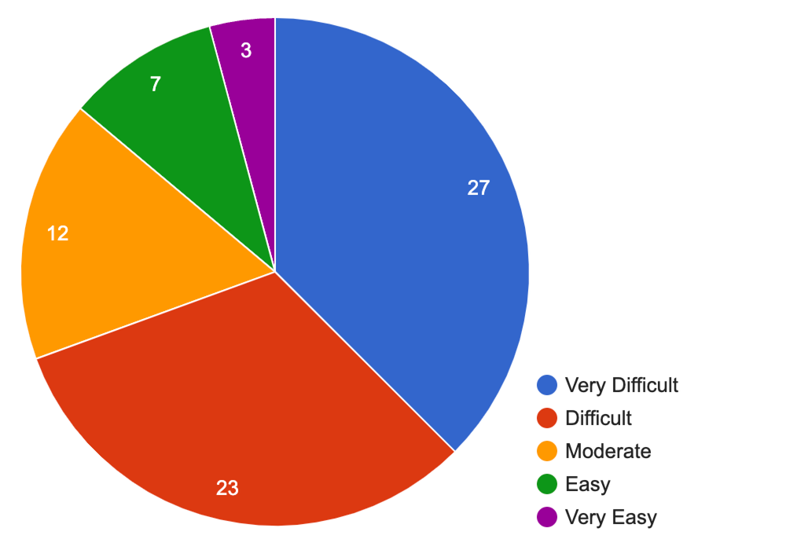
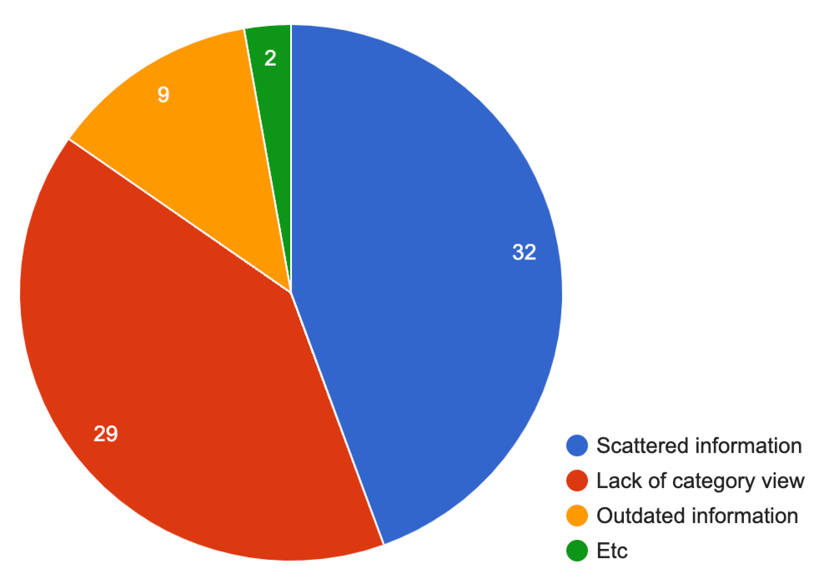
01 Background
Student survey : Searching Club Informations
[Ways to Discover University Clubs]
[Difficulty of Finding Club Information]
[Inconveniences When Searching for Club Information]
Students are having difficulties in searching club informations!

Slide 5



01 Background
Currently, students obtain information about the club through the following platforms.
주제 소개
[Everytime]
[School Webpage]
[CampusPick]
However, they all come with their own FATAL SHORTCOMINGS!

Slide 6
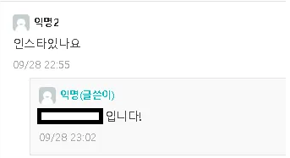
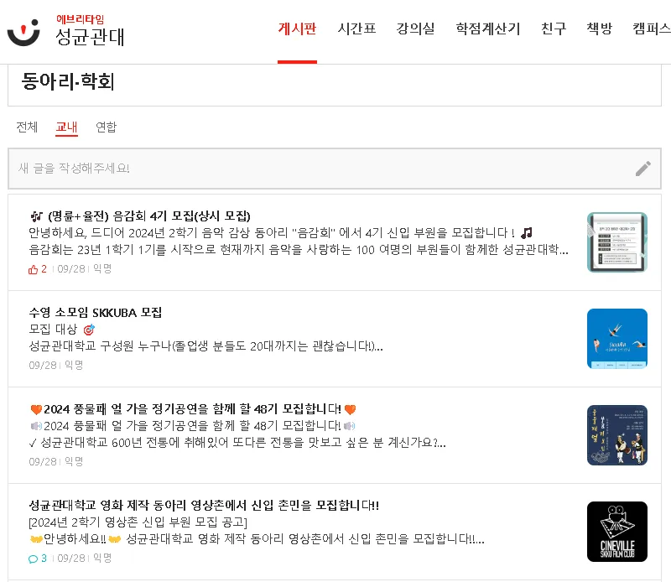

02 Problem
Absence of a category classification feature
Hard to find desired category
The format of the content varies for each post
Important information is sometimes missing.
[Everytime]
[Unrelated categories mixed together]
[Missing information]

Slide 7
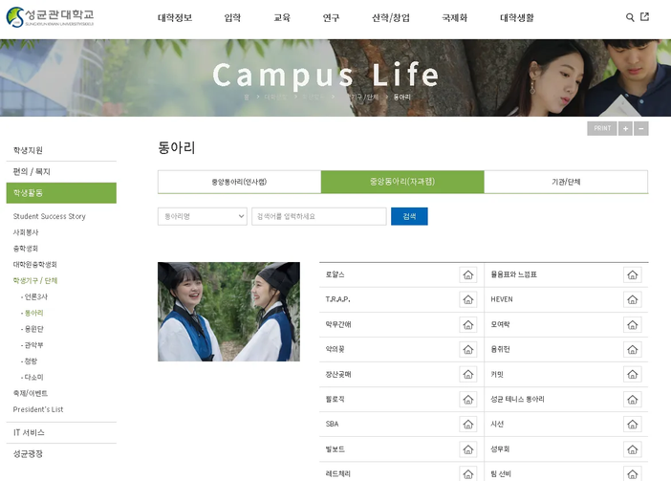
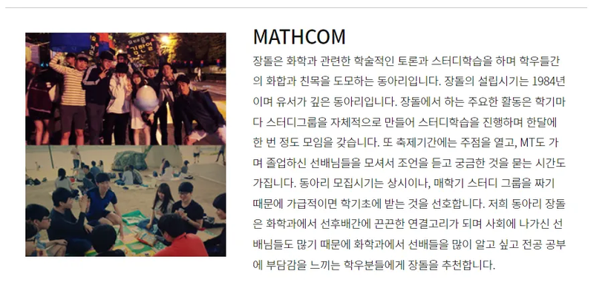
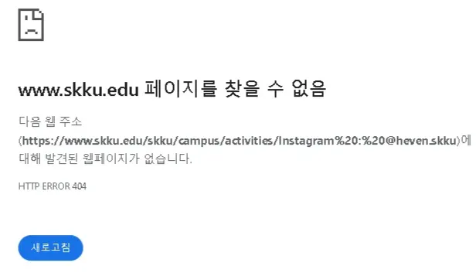
02 Problem
Club information is divided by college and posted on seperate webpage
Inconvenience of having to search through multiple websites.
Outdated and inaccurate information.
Low reliability
[School Webpage]
[Only about Central clubs]
[Wrong information]
[Invalid Link]

Slide 8
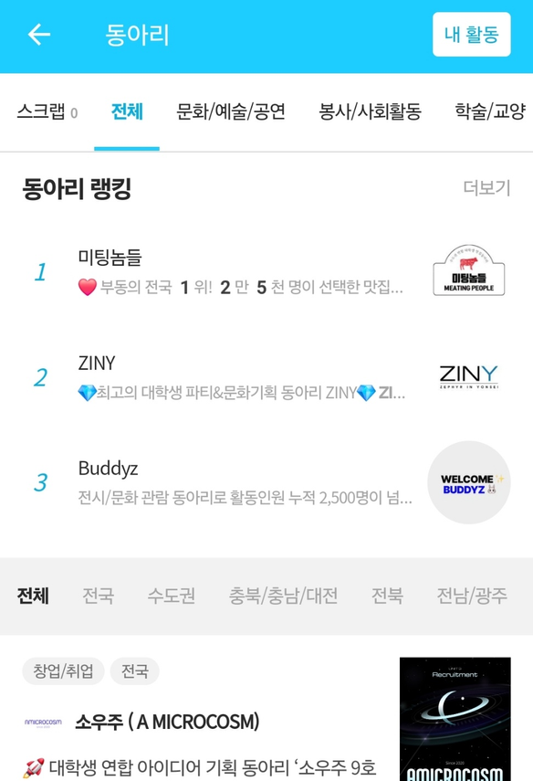
02 Problem
Not categorized by university
Cannot selectively view information about clubs from a specific university.
[CampusPick]
[No university category]

Slide 9
03 Solution & Expectation
[Classification and categorization of club information]
Students can easily explore clubs that match their interests
[Club information in standardized format]
This will prevent the omission of important informations
[Real-time updates of club information]
CircleSpace
This will improve accuracy and reliability of information
[Login system using university account]
This will ensure credibility of club information
[Notification system for favorite clubs]
This will improve communication between clubs and students
[Review and rating system]
Students can get help on choosing clubs
Club managers will able to use feedback to improve their club.

Slide 10







04 Technique
Front
Back
Spring Boot
Amazon RDS
React
Vite
Figma
Amazon S3
Amazon EC2

Slide 11





05 Architecture
DB
AWS
Amazon EC2
JPA
Amazon RDS
MySQL
QueryDSL
Storage
React
Spring
USER
Amazon S3

Slide 12
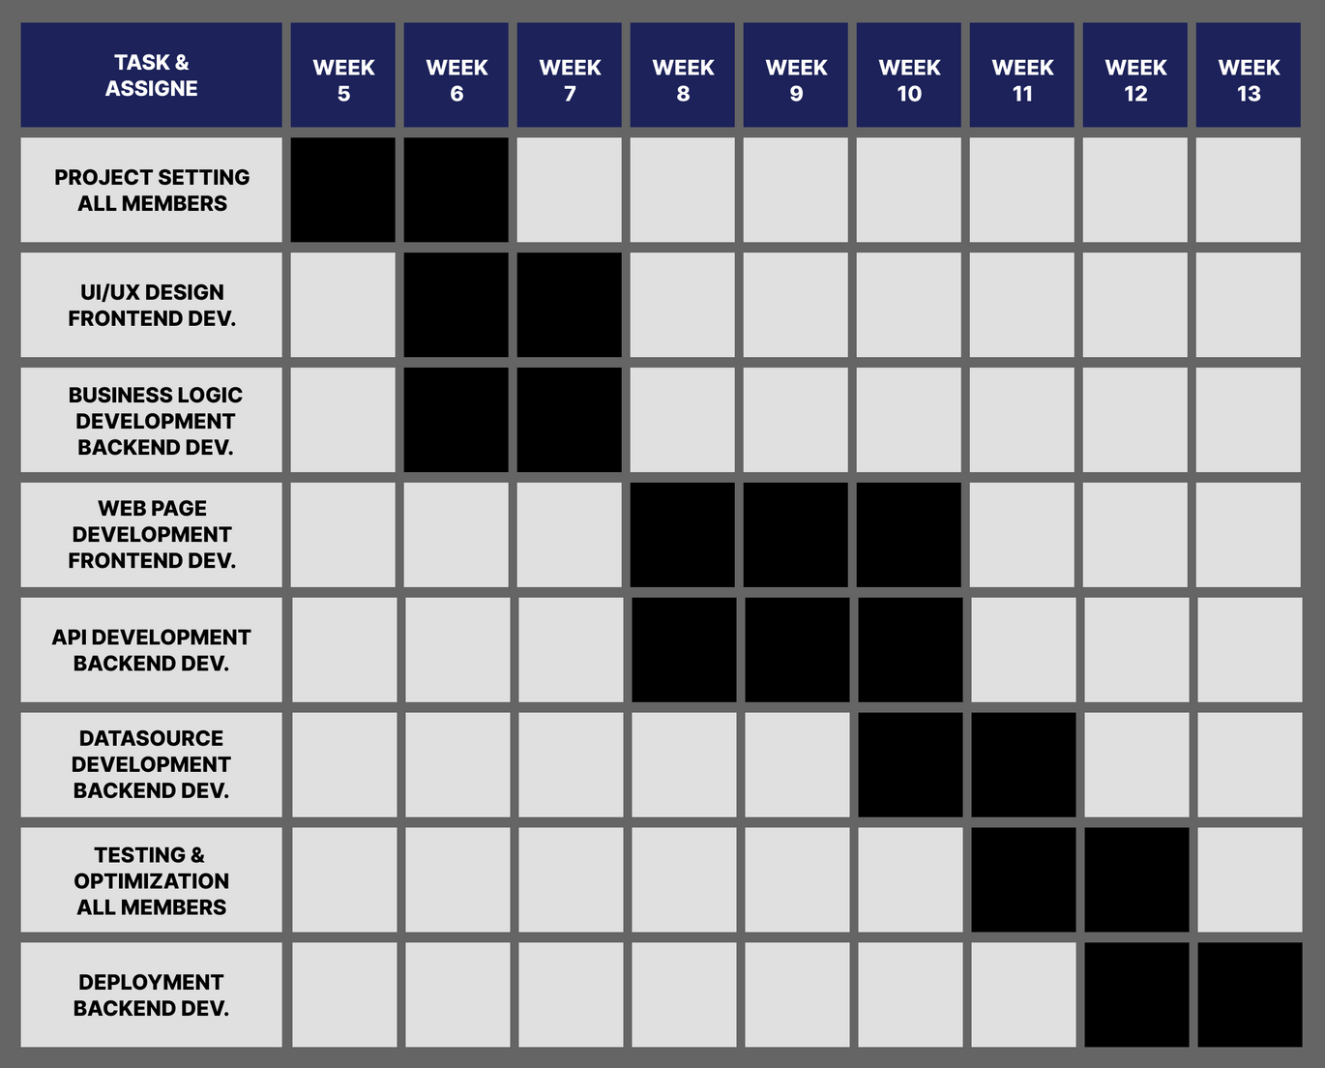
06 Development plan

Slide 13




06 Development plan
Project Manager
DB & API Developer
Seokhyun Bae
Backend Developer
Time keeper
Guho Kim
Web Designer
UI / UX Design
Jiwoo Chung
Frontend Developer
Page Implementation
Jinu Park

Slide 14
Q&A
CircleSpace : School club platform for all university students
날다람쥐랩 : 김구호 배석현 박진우 정지우

